Slide 1

.

Slide 2
اعداد: د رواد الخوري .
.

Slide 3
THYROID CANCER.
مؤتمر الرابطة السورية للأورام
حلب 2023-12-15

Slide 4
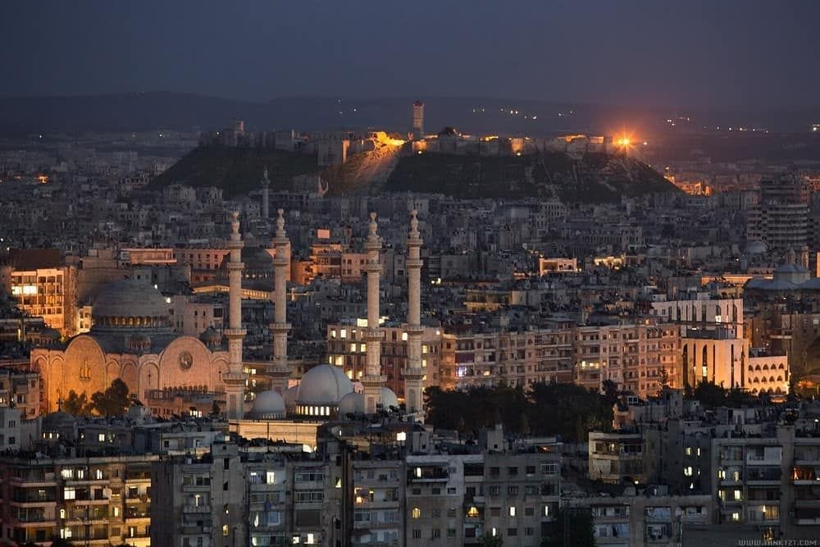
.

Slide 5
.
2019: 52070 ADULTS RECEIVED DIAGNOSIS OF THYRIOD CANCER IN USA.
2020 : with an estimated 747000 new cases diagnosed globally in 2020 according to (WHO).
DIFFERENTIATED THYROID CANCER (DTC): THE MOST COMMON TYPE OF THYROID CANCER;ACCOUNTING FOR ABOUT 95% OF CASES.
IT IS THE MOST COMMEN CANCER IN WOMAN AGED 20- 30 YEARS.
WOMEN ARE THREE MORE LIKELY THAN MEN.
WOMENAND MEN DIE AT SIMILAR RATES.
THE MEN PATIENTS HAVE WORSE PROGNOSIS THAN FEMALE PATIENTS .
THE 5 YEAR OS RATE FOR THYRIOD CANCERS IS ABOUT 98,5%

Slide 6
.

Slide 7
.

Slide 8
.

Slide 9
.
Table 2 Elements of thyroid ultrasound reporting in nodular thyroid disease.
1-Thyroid lobes Echogenicity
Size (three diameters and volume)
Presence of substernal extension or compression of cervical structure
2- Nodule Size (three diameters and volume)
Location (according to the three axes)
Echogenicity
Composition
Suspicious and non-suspicious signs if presenta
Possible extrathyroidal extension
3-Which discrete lesions should be described? Nodules larger than 10 mm.
Nodules between 5 and 10 mm with suspicious signs
4-How many nodules should be described in detail? The largest one and those with suspicious signs if the number of nodules is >3 in a lobeb
5-Pathologicalc lymph nodes if present Location, three diameters, features

Slide 10
.
Bethesda I
- EU-TIRADS 3 (>20 mm): repeat FNA. If still non-diagnostic, consider CNB. If still non-diagnostic, re-evaluate the nodule within 1 year or offer surgery
- EU-TIRADS 4 (>15 mm) and 5 (>10 mm): repeat FNA. If still non-diagnostic, consider CNB or, molecular testing (if available and sufficient material). If still non-diagnostic, offer active surveillance or surgery

Slide 11
.
Bethesda II
- EU-TIRADS 3 (>20 mm) and 4 (>15 mm): re-evaluate the nodule in 3–5 yearsd
- EU-TIRADS 5 (>10 mm): repeat FNA

Slide 12
.
Bethesda III
- Repeat FNA regardless of EU-TIRADS class
- EU-TIRADS 3 (>10 mm), with repeat Bethesda III: re-evaluate the nodule within 1 year, consider molecular testing if available or offer surgery
- EU-TIRADS 4 and 5 (>10 mm), with repeat Bethesda III: offer surgery or active surveillance; molecular testing if available

Slide 13
.
Bethesda IV
- All nodules, regardless of EU-TIRADS class: offer surgeryg; molecular testing if available

Slide 14
.
Bethesda V and VI
- All nodules, regardless of EU-TIRADS class: recommend surgeryh
- Active surveillance and MIT may be considered in patients with 5-10 mm nodules, in the absence of suspicious lymph nodes or risk of extra-thyroidal extensioni
- Multidisciplinary workup is warranted in case of advanced cancer

Slide 16
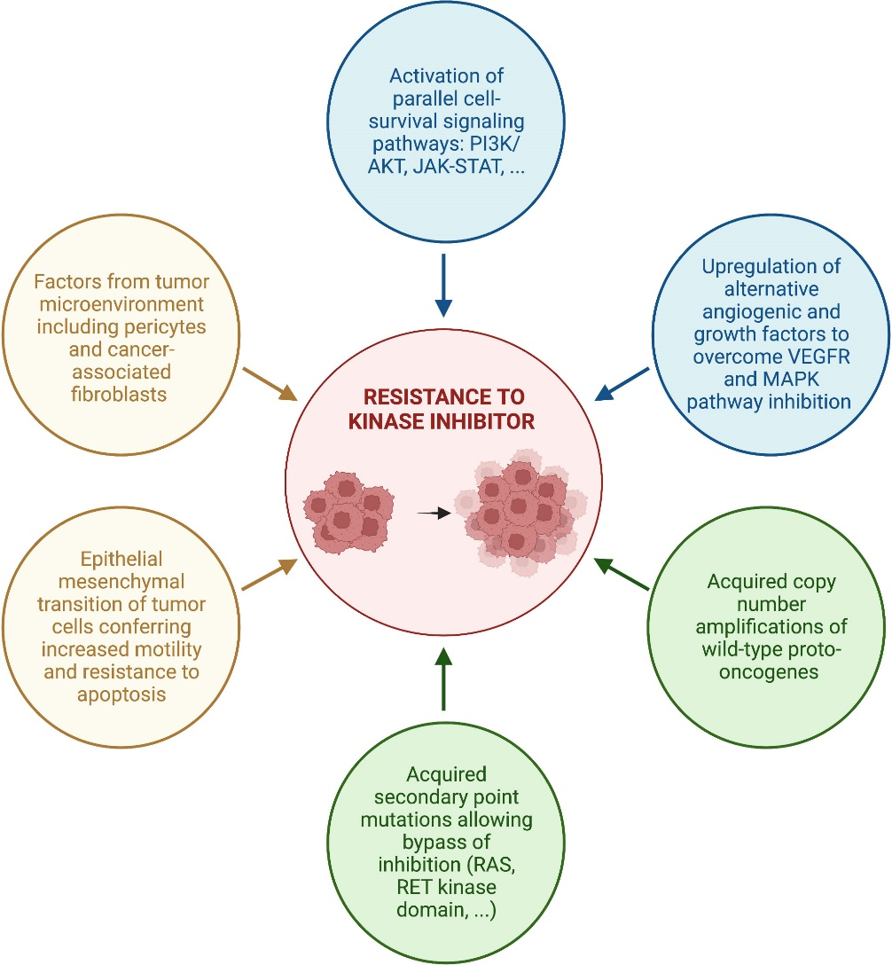

Slide 17
THYRIOD CANCER
1- PTC ( PAPILLARY THYRIOD CANCER)
2- FTC ( FOLLICULAR THYRIOD CANCER)
3- MTC ( MEDULLARY THYRIOD CANCER)
4- ACA ( ANAPLASTIC THYRIOD CARCINOMA)
5- OCA (ONCOCYTIC CARCINOMA OF THYRIOD)
6- PDTC (POORLY DIFFERENTIATED THYRIOD CANCER)
7- DHGTC ( DIFFERENTIATED HIGH –GRADE THYRIOD CANCER)
8- IEFV-PTC ( INVASIVE ENCAPSULATED FOLLICULAR VARIENT PAPILLARY THYRIOD CANCER)

Slide 19
ASCO 2023:
1- FOLLICULAR CELLS:
1- DIFFERENTIATED (90%):
- PAPILLARY (80-85%):
BRAF V600E (70%) – RET FUSION (7-10%)
NTRK FUSION(10-20%)- ALKFUSION (2%)
- FOLLICULAR (10-15%):
RAS MUTATIONS (30-45%)
- HURTHLE CELL (3-5%)
RET<10%
2- ANAPLASTIC (1-2%):
BRAF V600E 60% - RET<10 %

Slide 20
.
2- PARAFOLLICULLAR:
1- MEDULLARY(5-9%):
- SPORADIC (75%):
RET 60%
- FAMILIAL (25%):
RET 90-100%

Slide 21
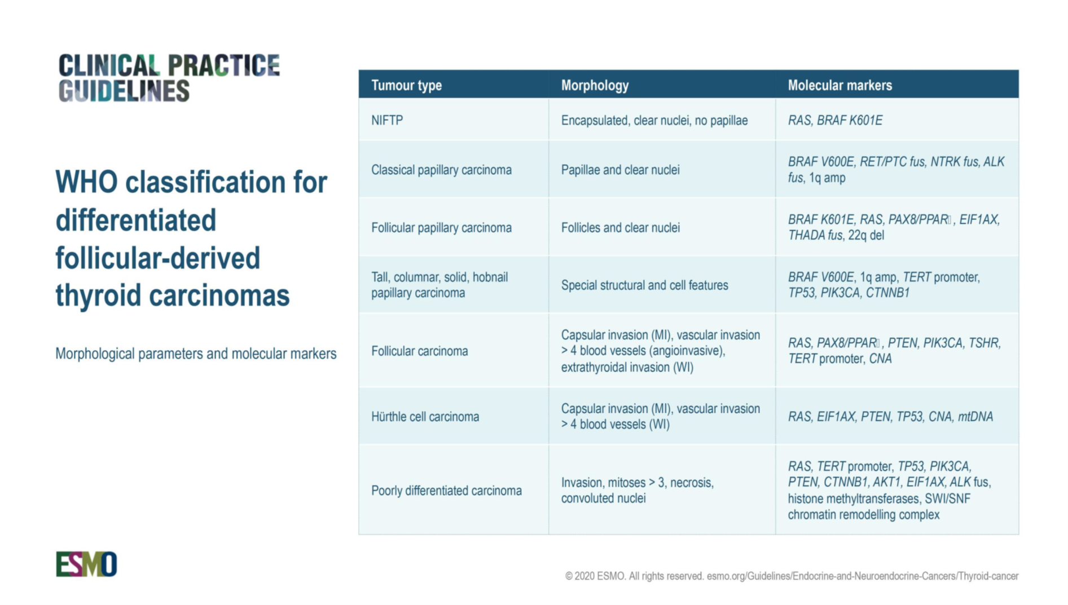

Slide 22
DIFFERENTIATED THYRIOD CANCER (DTC)
The only etiologic factor is radiation exposure that relationship between age at exposure and risk for development of thyroid cancer.
Approximately 5% of differentiated DTCs are associated with hereditory syndromes such as: GARDNER SYNDROME- COWDEN SYNDROME- PENDRED SYNDROME
WERNER SYNDROME AND CARNEY SYNDROME.
FAMILIAL DTCs are usually multifocal and bilateral and have a tendency to recur both locoregionally and in distant sites.
FAMILIAL PAPILLARY THYRIOD PTCs appear to be clinically more aggressive than sporadic ones.

Slide 23
.
Several factores accepted as being associated with poor prognosis:
1-AGE > 55 YEARS
2- MALE SEX
3- POORLY DIFFERENTIATED HISTOLOGY
4- TUMOR>1,5 CM
5- EXTRATHYRIOD EXTENTION AT DIAGNOSIS
NOTICE:
Involvement of regional lymph nodes is associated with a greater for nodal recurrence but dose not confer a worse prognosis for survival.

Slide 24
.
TWO MULTITARGETED TKIs , SORAFINIB AND LENVATINIB approvedby FDA for treatment of radioactive iodine refaractory DTC independent of mutional status.
If the disease dose not respond to treatment SORAFENIB AND LENVATINIB.
PHASE 3: randomized trial studing CABOZANTINB .
THE PFS for CABOZANTINIB was not reached

Slide 25
.
For BRAF V600E MUTANT DTC ,VEGF TARGETING TKIs such as LENVATINIB remain the first line choice.
LAROTRETINIB AND ENTRECTINIB are highly effective in tumor with NTRK FUSIONS.
SELEPERCATINIB AND PROLSETINIB have strong affinity for tumors driven by RET FUSIONS.
Thyriod cancers with ALK FUSIONS have shown responses to CRIZTINIB , CERITINIB AND ENTRECTINIB ( which is an INHIBITOR OF NTRK, reactive oxygen species and ALK)
CYTOTOXIC CHEMOTHERAPY has no role in the treatment of this disease

Slide 26
.
Management of advanced/metastatic disease
DTC( DIFFERENTIATED THYRIOD CANCER )
Radioactive iodine therapy
• Patients with distant metastases should receive 100–200 mCi (3.7–7.4 GBq) of 131I after TSH stimulation
• Non-RAI-avid lesions and those that lose their ability to concentrate RAI or progress despite RAI avidity should be considered RAI-refractory
• Between treatments, suppressive doses of levothyroxine are given to maintain serum TSH levels <0.1 lIU/ml (unless there are specific contraindications)
Locoregional therapy
• Single lesions that are symptomatic or progressive may be eligible for locoregional treatments (e.g. palliative surgery, EBRT, percutaneous therapies)
• Bone resorption inhibitors (bisphosphonates and denosumab) can be used alone or combined with locoregional treatments in the management of thyroid
cancer-related bone metastases
• There is limited evidence that conservative techniques (RFA, cryotherapy) are effective for treating TC-related bone lesions
• Metastasectomy is not the standard approach for lung metastases but it may be considered for oligometastasis in patients with good PS
• RFA is a possibility for solitary lung lesions or those causing a specific symptom due to their volume and location
• Invasion of the upper aerodigestive tract should always be excluded in TC patients with locoregional disease
Systemic therapy and personalised medicine
• TSH suppression (serum level <0.1 lIU/mL) is recommended for all TC patients with persistent structural disease in the absence of specific contraindications
• Decisions on whether or not to use MKIs must always be based on patient preference after a careful discussion with the managing physician of the
expected benefits and risks associated with specific drugs
• Lenvatinib and sorafenib should be considered the standard first-line systemic therapy for RAI-refractory DTC .

Slide 32
. TABLE 1 FDA-approved Drugs in advanced RR-DTC
.

Slide 33
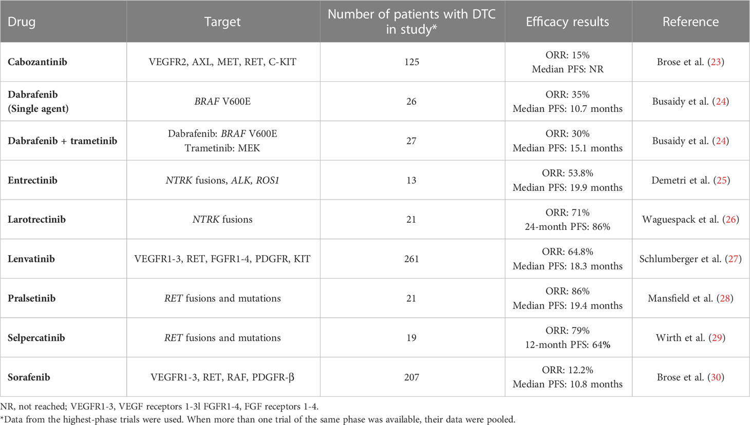

Slide 34
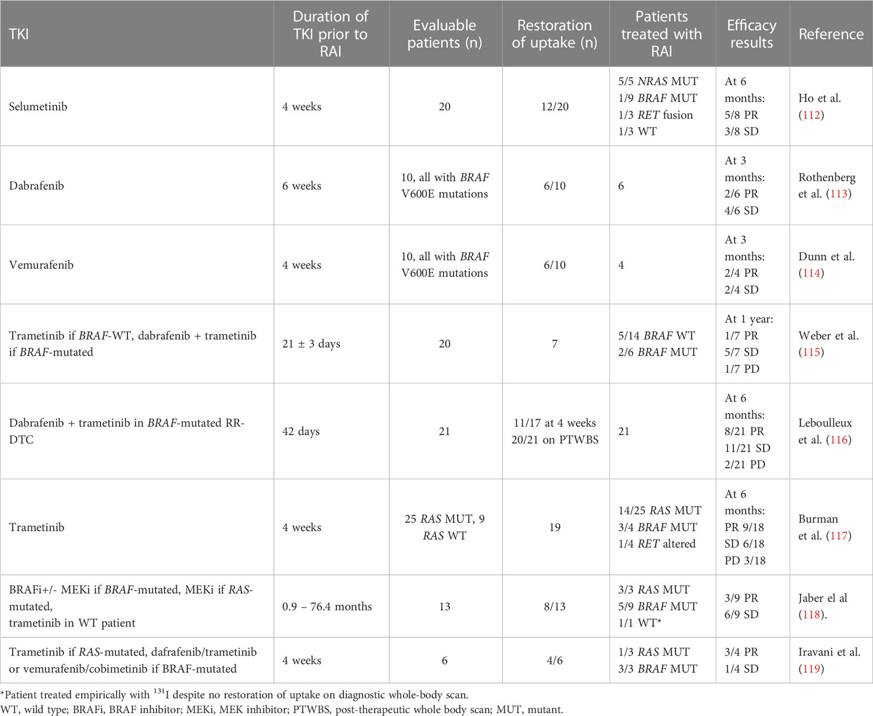

Slide 35
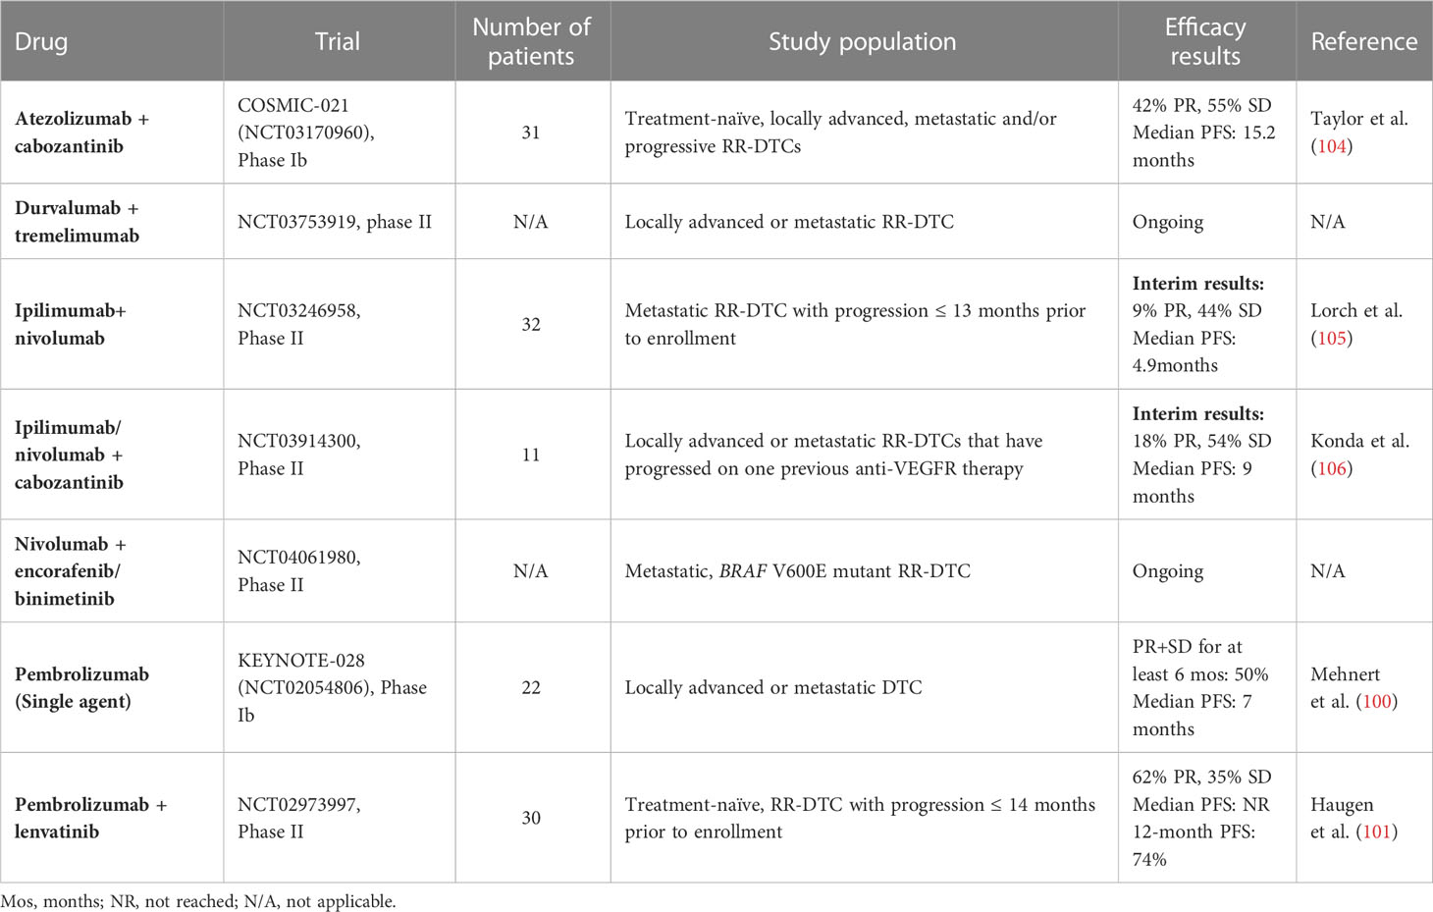
.

Slide 37

.

Slide 38
sorafenib
.SORAFENIB TARGETS PROTO-ONCOGENE :
BRAF- RET- VEGFR 1-3 AND PROTO ONCOGENE
C- KIT -
SORAFENIB WAS APPROVED BY FDA IN 2013 : INVOLVED IN TUMOR GROWTH,ANGIOGENESIS,AND METASTASIS. .
A TOTAL OF 417 PATIENTS WHO HAD LOCALLY ADVANCED OR METASTATIC THYRIOD CANCER THAT WAS REFRACTORY TO RADIOACTIVE IODINE AND PROGRESSION WITHIN THE PAST 14 MONTHS WERE RANDOMLY ASSIGNED TO RECEIVE 400 MG OF ORAL SORAFENIB TWICE DAILY.

Slide 39
.
SORAFENIB EXTENDED THE MEDIAN PFS FROM 5,8 MONTHS TO 10,8 MONTHS (P<.,0001)
MEDIAN OS WAS NOT STATISTICALLY SIGNIFICANT.
THE DISEASE CONTROL RATE :
( COMPLETE RESPONSE PLUS PARTIAL RESPONSE PLUS STABLE DISEASE > 6 MONTHS) WAS 54% IN THE SORAFENIB ARM COMPARED WITH PLACEBO ARM(P<.0001)
NO COMPLETE RESPONSE RATES AND PRATIAL RESPONSE OF 12% WERE REPORTED.

Slide 40
.
THE MOST COMMON GRADE 3 OR 4 TOXICITIES INCLUDED:
HAND-FOOT SYNDROME 76%
DIARRHEA 69%
FATIGUE 50%
HYPERTENSION 41%

Slide 41
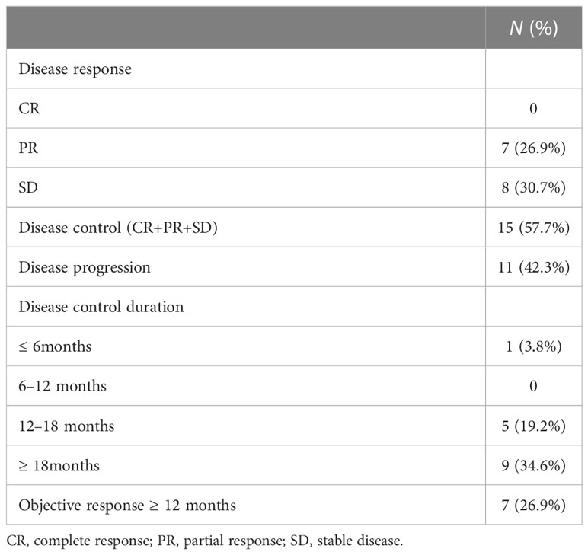
.

Slide 42
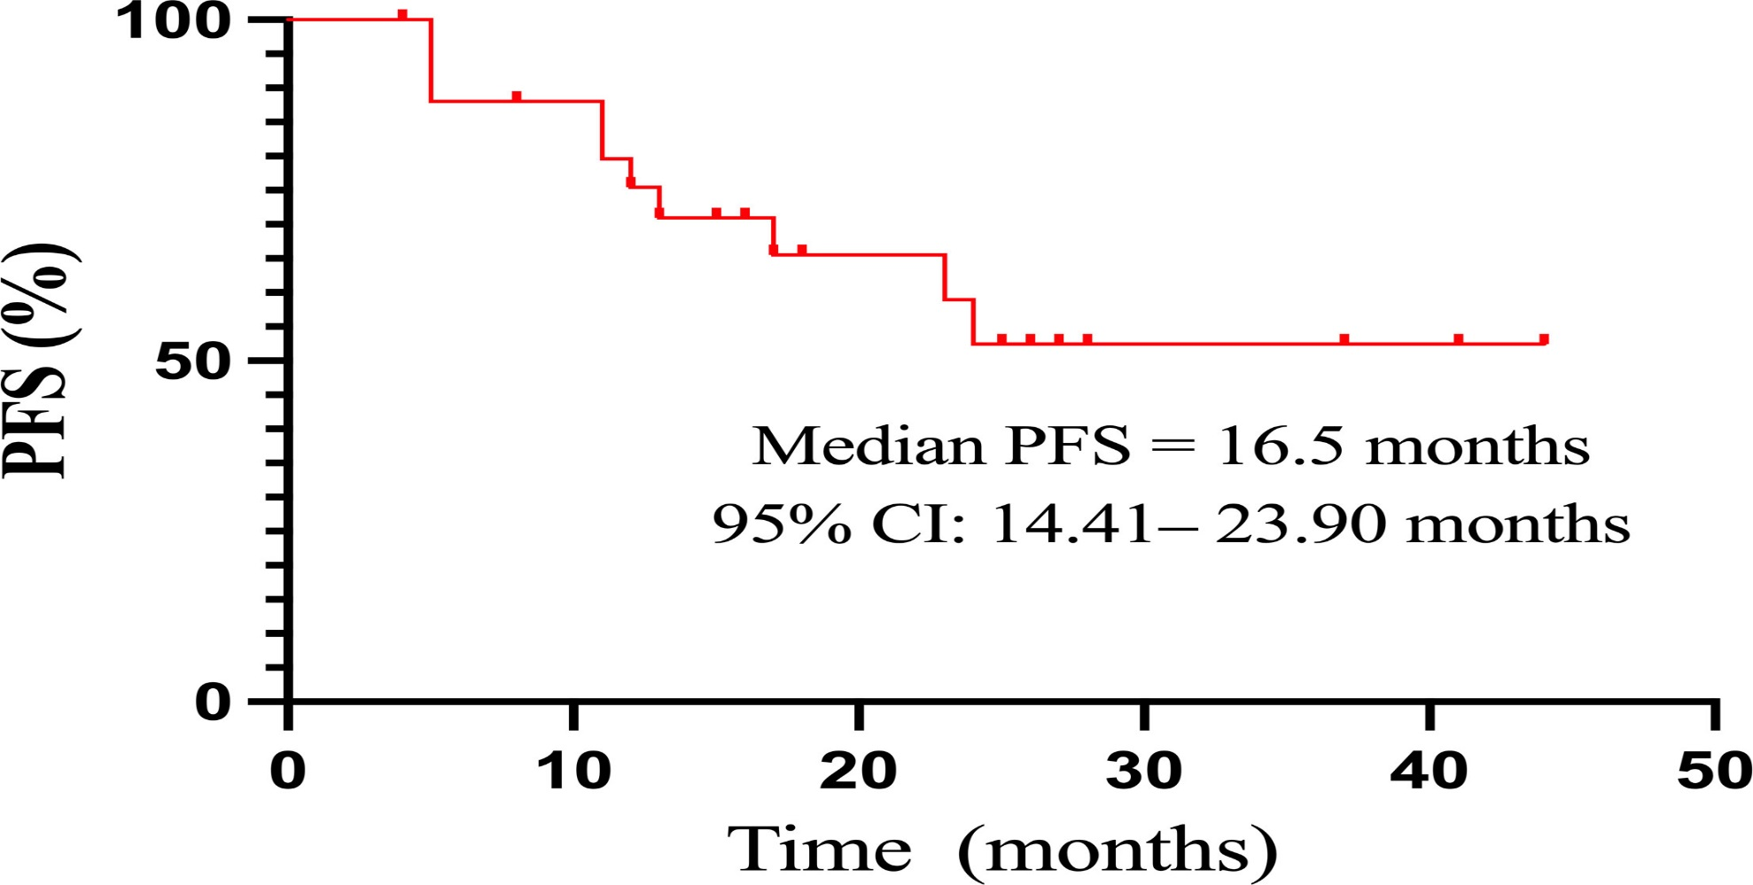
Figure 2 The Kaplan–Meier curve of PFS in 26 patients treated with sorafenib. CI, confidence interval; PFS, progression-free survival..

Slide 43
Figure 3 Kaplan–Meier curves of PFS according to clinicopathological features. PFS, progression-free survival.
.

Slide 44
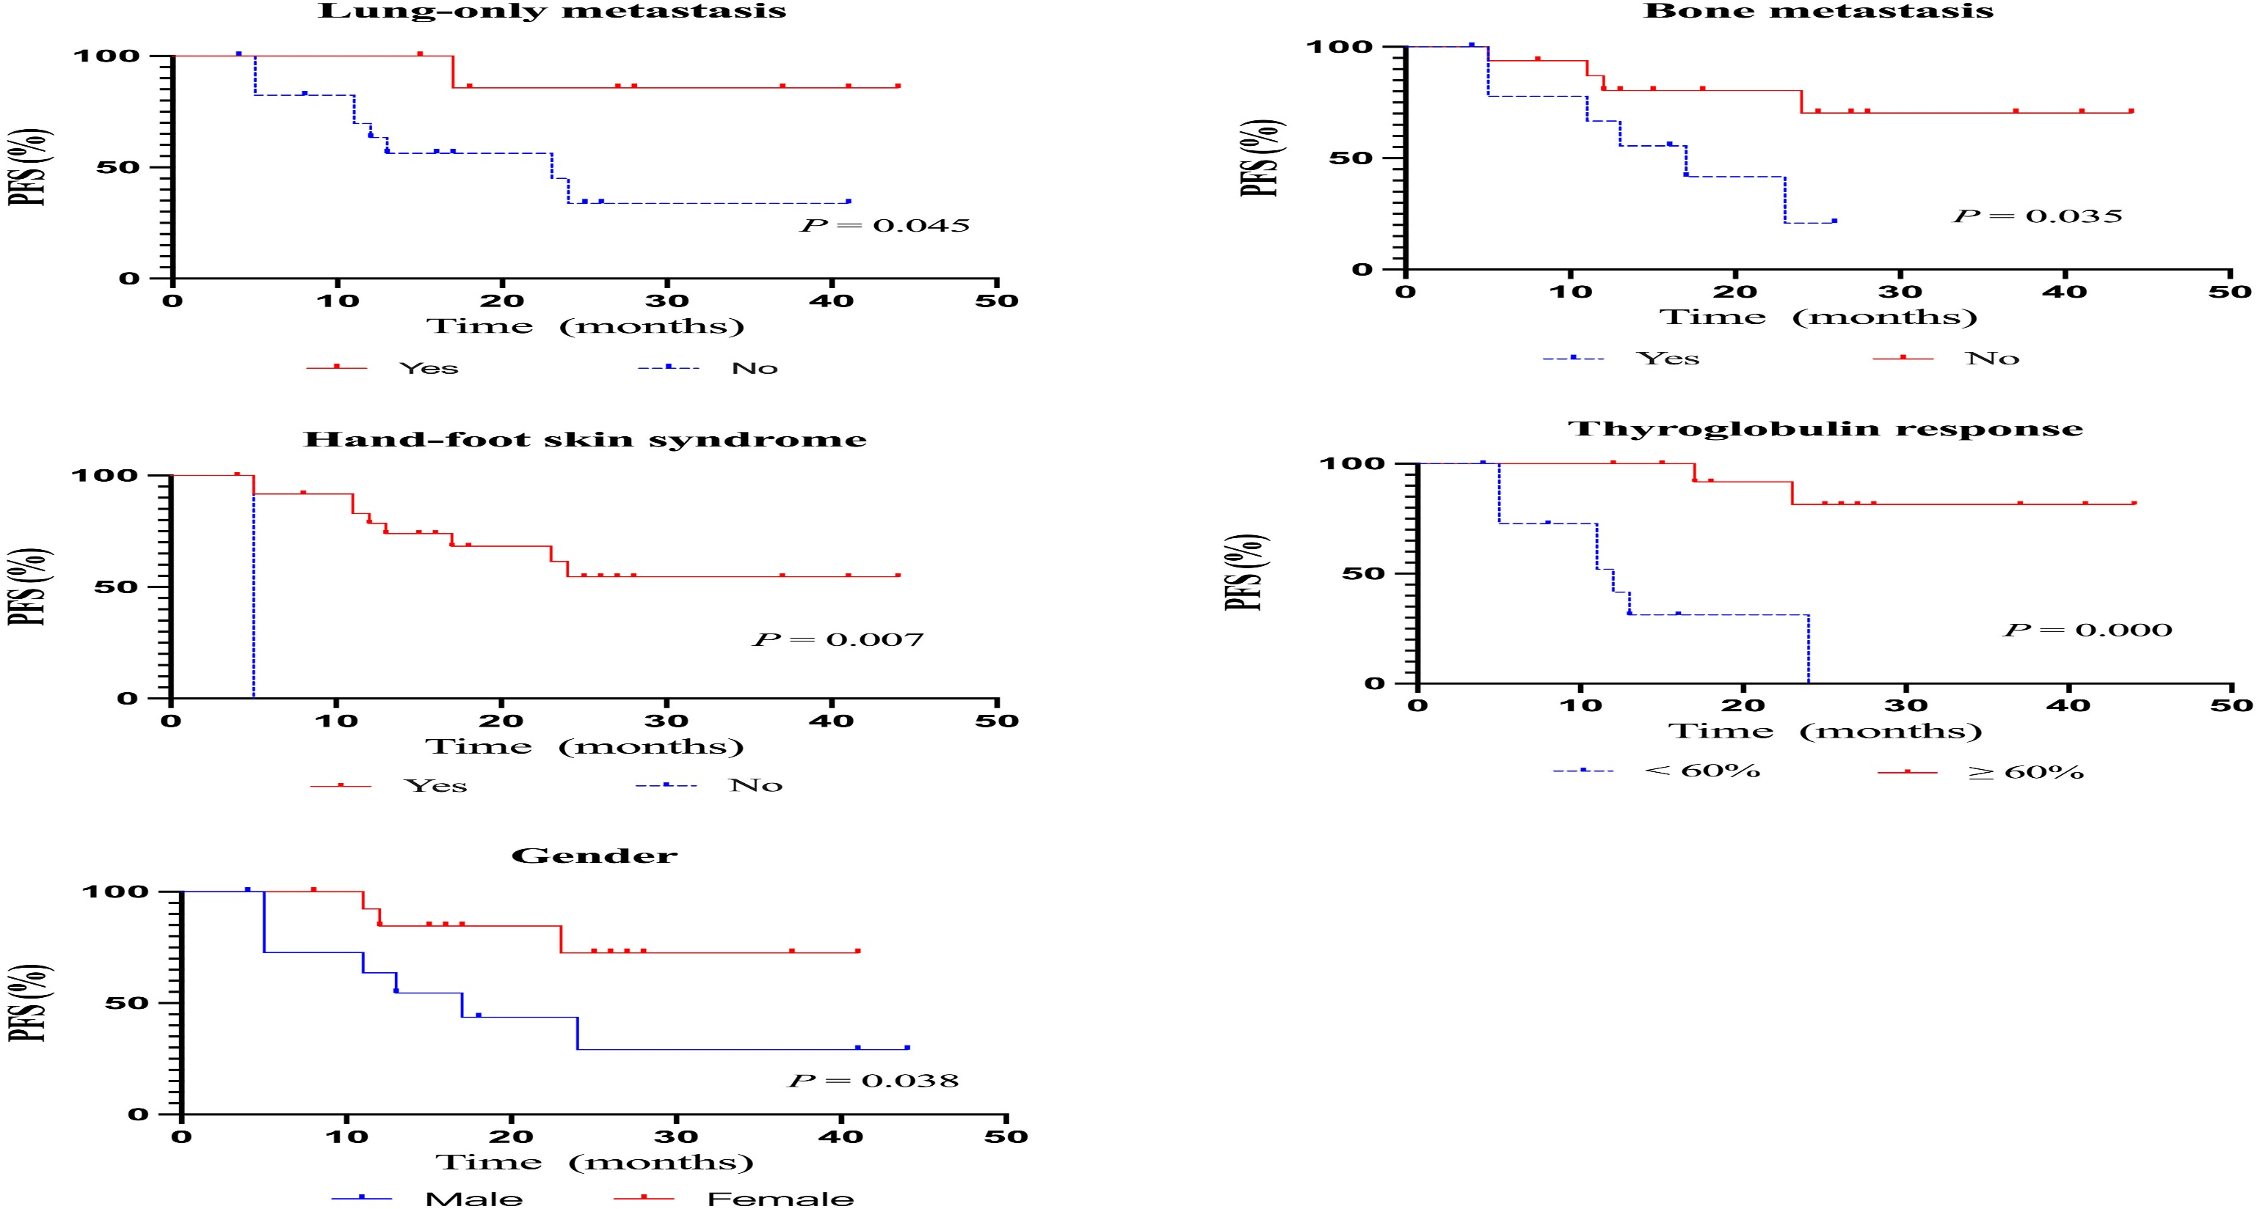
.

Slide 45
Adverse events occurring in patients treated with sorafenib.
.

Slide 46
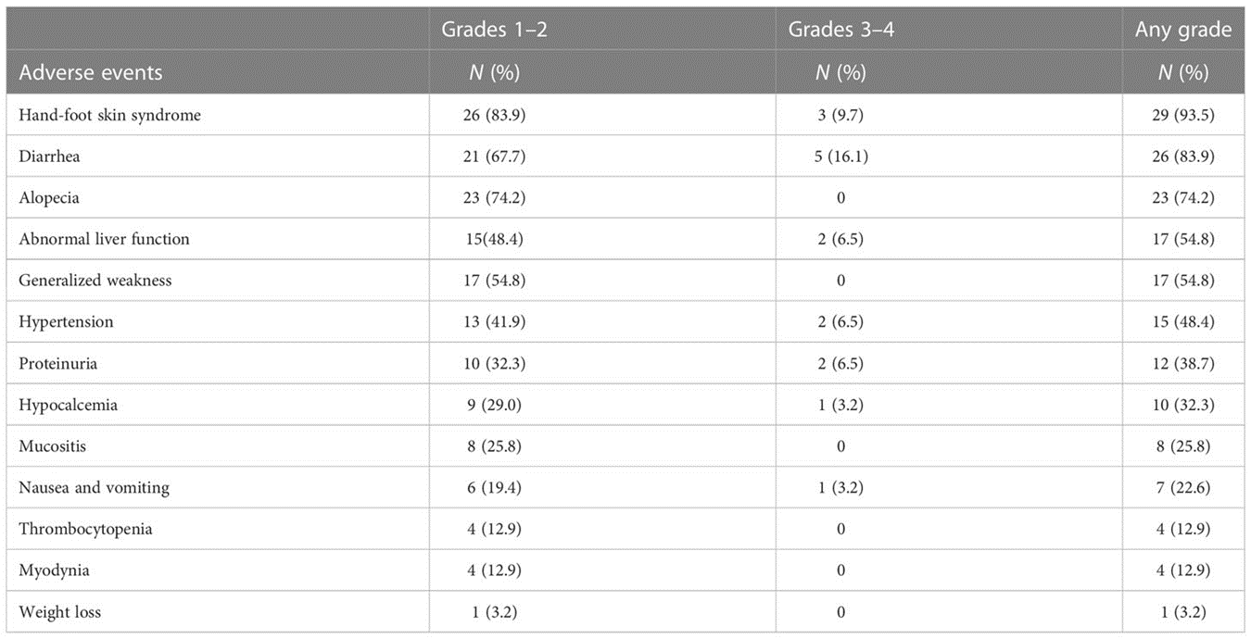

Slide 47
LENVATINIB
LENVATINIB INHIBITS :
VEGFR1-3 – FIBROBLAST GROWTH FACTOR RECEPTOR 1-4- PLATLET-DERIVED GROWTH FACTOR-@-RET AND KIT .
DRUG: 24 MG DAILY
THE MEDIAN PFS WAS 18,3 MONTHS

Slide 48
.
TOXICITIES INCLUDED:
HYPERTENSION 68%
DIARRHEA 59%
ANOREXIA 50%
FATIGUE 49%
WEIGHT LOSS 46%

Slide 49
.
ATC (ANAPLASTIC THYRIOD CANCER):
SYSTMIC THERAPY AND PERSONALISED MEDICINE .
PATIENT WITH BRAF V600E-POSITIVE MALIGNANCIES SHOULD BE TREATED WITH BRAF INHABITOR DABRAFENIB (150 mg twice daily)
PLUS MEK INHIBITOR TRAMETINIB (2mg once daily)
THE TREATMENT OF BRAF V600E –MUTATED ATCs is 69% response rate and estimated 12 month PFS and OS rates of 79% and 80% respectively.

Slide 50
ANAPLASTIC THYRIOD CANCER
AGENTS(DOSAGES) REGIMEN
PACLITAXIL 30-60 MG /M2 IV WEEKLY
DOCETAXIL 20 MG/M2 IV WEEKLY
PACLITAXIL+CARBOPLATIN 50 MG/M2 + AUC2 IV WEEKLY
DOCETAXIL+ DOXORUBICIN 20MG/M2 IV + 20 MG/M2 IV WEEKLY

Slide 54
.
MTC (MEDULLARY THYRIOD CANCER)
SYSTEMIC THYRAPY AND PERSONALISED MEDICINE
CABOZANTINIB AND VENDETANIB ARE THE FIRST-LINE SYSTMIC THERAPY FOR PROGRESSIVE METASTATIC MTC .
IN PATIENTS WITH RETM918T OR RAS-MUTANT MTCs
CABOZANTINIB offers significant PES AND OS advantages OVER WILD –TYPE MTCs.
There is little evidence to support the use of either chemotherapy or radionuclide therapy in patients with MTC although either might be considered when MKI(MULTIKINASE INHIBITOR)are contraindicated

Slide 56
.
For MTC patients whose tumors harbor RET MUTATIONS known to be sensitive to new more selective RET INHIBITORS ( SELPERCATINIB , PRALSETINIB ) these agents have displaced LENVATINIB AND CABOZATINIB as first line treatment .
SELPERCATINIB is an FDA approved selective RET KINASE in inhibitor for RET ALTERED MTC AND RET FUSION POSITIVE RADIOACTIVE IODINE- REFRACTORY THYRIOD CANCER WITH ADVENCED OR METASTATIC DISEASE .
76% of these responses for at least 6 months.
The median duration of response was 22 months.

Slide 57
.
PRALSETINIB is an FDA approved selective RET KINASE in inhibitor for RET ALTERED MTC AND RET FUSION POSITIVE RADIOACTIVE IODINE- REFRACTORY THYRIOD CANCER WITH ADVENCED OR METASTATIC DISEASE .
80% of these responses for at least 6 months.
The median duration of response had not yet been reached.

Slide 60
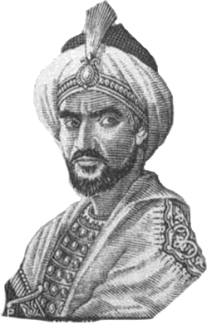
الملك الذي حمل السيف و القرطاس

Slide 61
أبو فراس الحمداني التغلبي
أراك عصي الدمع شيمتك الصبر
أما للهوى نهي عليك ولا أمر؟
وقال أصيحابي : الفرار أو الردى؟
فقلت أمران أحلاهما مرُ
سيذكرني قومي اذا جدً جدٌهم
وفي الليلة الظلماء يفتقد البدر
ونحن أناس لا توسط بيننا
لنا الصدر دون العالمين أو القبر
تهون علينا في المعالي نفوسنا
ومن خطب الحسناء لم يغلها المهر
أعزُ بني الدنيا وأعلى ذوي العلا
وأكرم من فوق التراب ولا فخر

Slide 62
.
شكرا لاصغاكم

